Slide 1

ELI PROJECT
Where is Threshold to Passenger Discomfort?
Guided By:
Prof. John Burr

Slide 2
Table of contents
Problem Statement / Project scope
Project Approach
Clustering Methods
Simulated Data
Results- Dendrogram and analysis
Tokenization
NLP Formulation
Security( API)
Scaling Consideration
KPI's / Measure of success
Next steps

Slide 3
Project Scope
Problem Statement
Griffith Foods manages diverse recipes, possibly causing redundancy in SKU management.
Goal: Utilize recipe similarities to identify undifferentiated SKUs.
Strategically consolidate SKUs to enhance manufacturing efficiency.
Minimize complexity in manufacturing processes.
Exploration of SKU reduction by advanced quantitative analysis using Clustering methods with dimensions like amount of ingredients and their description.
Comprehensive approach integrating clustering methodologies and user-friendly search system development.
Balancing organizational needs with formulators' creative endeavors.

Slide 4
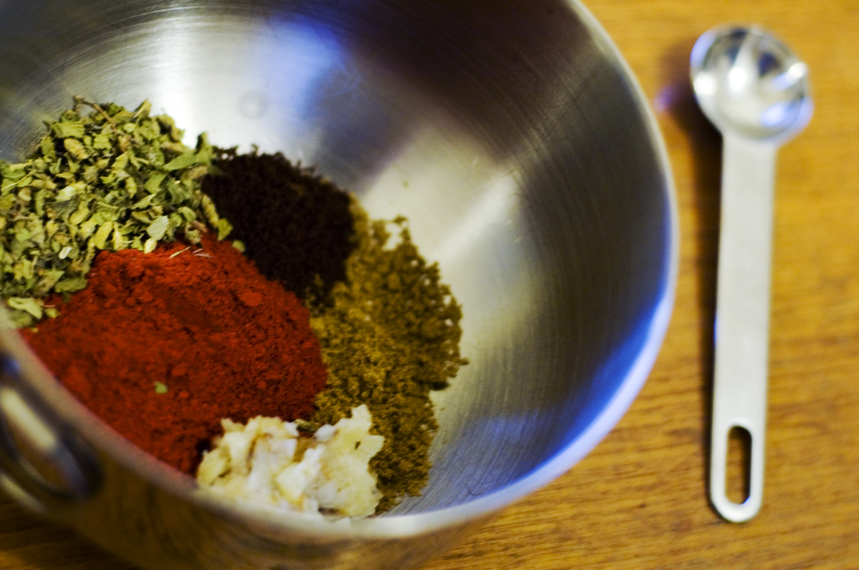
Approach
To understand recipes that are overlapping with minor or no differences
Use Advance quantitative analysis like “Clustering methodologies” to understand recipes with minor or no differences.
Perform Clustering based on ingredients weights and performed tokenization using NLP

Slide 5
Clustering Method
Clustering: algorithm for grouping the data points into a collection of groups based on the principle that similar data points are placed together in one group known as clusters.
Clustering Method | Disadvantages
K-means Clustering | Requires predefined number of clusters
DBSCAN | Requires setting of two parameters
Mean Shift Clustering | Computationally intensive
Gaussian Mixture Models (GMM) | Sensitive to initialization and Computationally expensive
Fuzzy C-means (FCM) | Requires setting of fuzziness parameter and Sensitive to noise
Hierarchical Clustering
Easy Interpretation( vis) - Dendrogram
No Fixed Cluster Number Needed
Spotting Recipe Overlaps
Works with Recipe Differences
Seeing Recipe Connections (visuals)
Incremental Adjustability - Merge or split clusters as needed

Slide 6
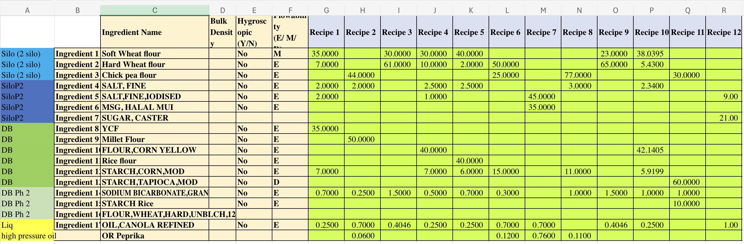
Simulated data

Slide 7
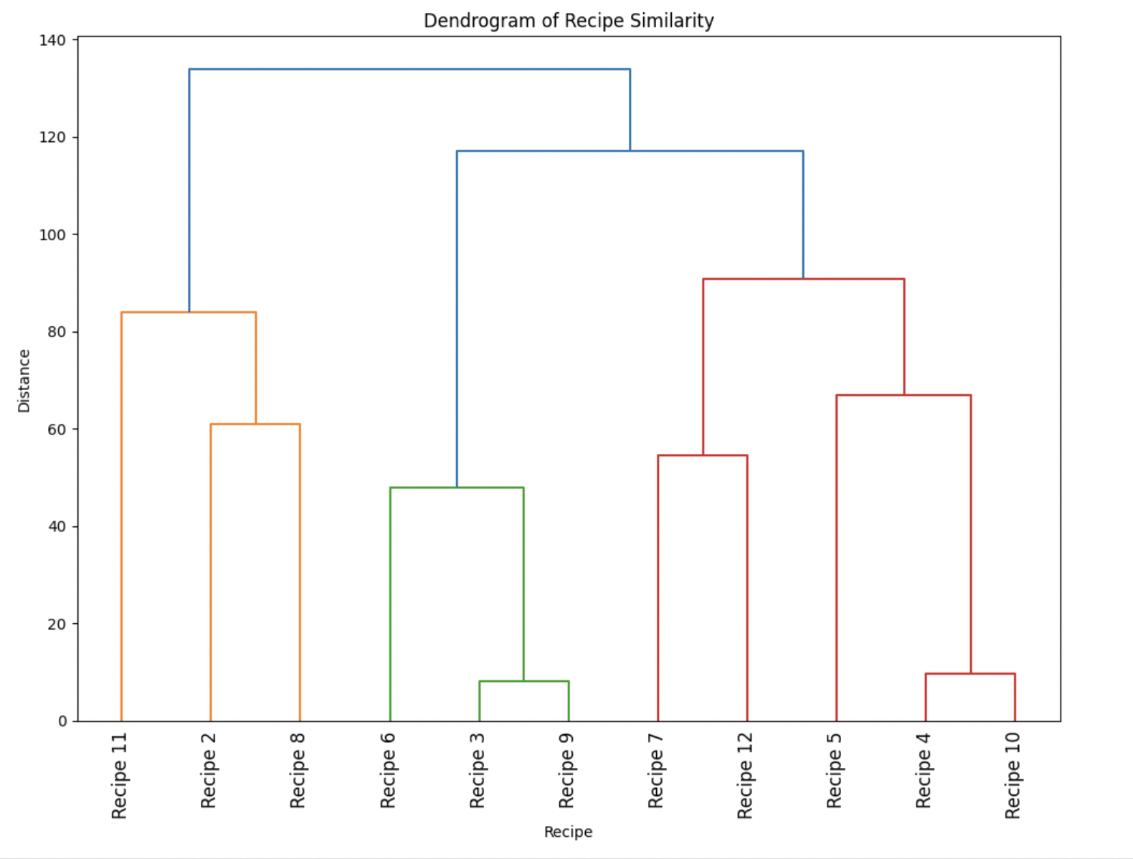
Dendrogram for similarity of recipes
Analyze the Dendrogram:
Branches that link together at lower heights indicates high similarity.
Recipe 3 & 9 are very similar to each other as they are linked at lower heights.
Recipes that do not join other clusters until higher levels might be considered unique recipes,
Dendrogram or clustering is governed by the highest weight in the recipes.

Slide 8
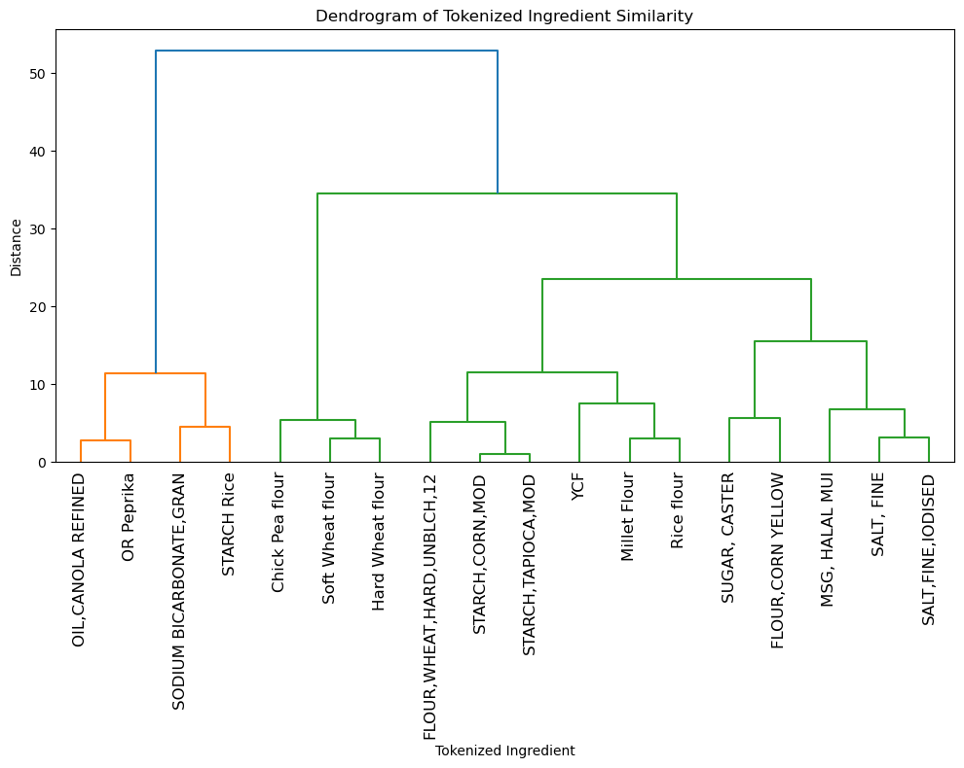
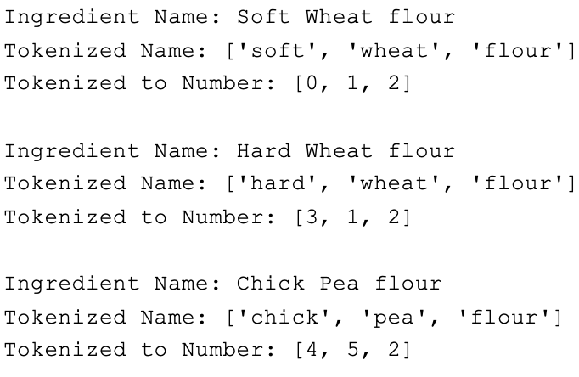
Tokenization in Recipe Clustering
Break down textual data, such as ingredient names, into individual tokens/ numeric tokens
Example -
Green Apple [0, 1]
Red Apple [2, 1]
Every word in the ingredient name has a number output associated with it.
Results
Ingredients with similar names cluster together.
Similarity in name doesn't guarantee similarity in properties.
Hence, not suitable for ingredient standardization.
Notes:
The dendrogram of tokenized ingredients showed that ingredient names which were most similar were the closest legs of dendrogram.
Ingredients similar in name are not necessarily same in properties. Hence, this approach cannot be used for standardization of ingredients.

Slide 9
NLP for formulation/Description
Natural Language Processing gives you the ability to search formulas if the recipe descriptions are rewritten in future.
NLP enables formula searches by rewriting them into regular language.
Detailed descriptions facilitate keyword identification for comprehensive searches.
Simplifying formulations allows for better keyword-based searching.
Currently, Complex notation in current formulations impedes this simplification process.
Notes:
Natural language processing gives the ability to search formulas if they are rewritten using regular language to describe details about the formulations
It basically knowing what all the keywords should be and being able to search on all those keywords.
But currently, the formulations are denoted in very complex format, and hence this simplification wasn't possible

Slide 10


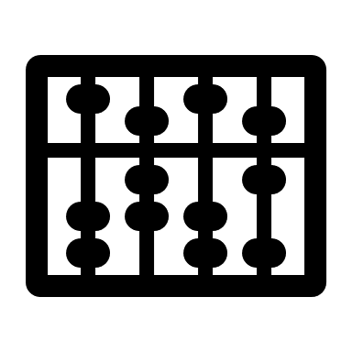


Impact of the Project
Reduce changeover costs associated
Can leverage Economies of Scale
Reduce Complexity
Will benefit the Manufacturing, Operations and Logistic Team
Reduce Capital Expenditure by Simplification of Product line

Slide 11


Scaling Insights
Limited Data- With a few recipes and data constraints, employing a more sophisticated model can better uncover the intricate patterns and complexities inherent in the data.
Interpretation - The inclusion of a vast array of recipes in the actual data would yield highly intricate dendrograms, posing challenges in interpretation due to their complexity.

Slide 12
Security Precautions
Open AI – OpenAI's tools and models are safe for companies with proper safety measures and considerations.
API – Proper data handling, API security, and ethical compliance mitigate data leakage risk, ensuring safe use of OpenAI for NLP and AI applications.

Slide 13

Future Steps
Near Future:
Get IT involved: Have them set up systems to use real data for better decision-making.
Long Term:
Improve operations: Group similar recipes to streamline processes and make operations more efficient.
Far-Fetched Idea:
Rewrite ingredient descriptions: Make them easier to understand for better search results.
R&D/Formulation Work group - Use keywords to find past recipes: This helps in customizing new versions instead of starting from scratch.

